Slide 1
PySINDy Notes 0715
Liam A. Pocher

Slide 2
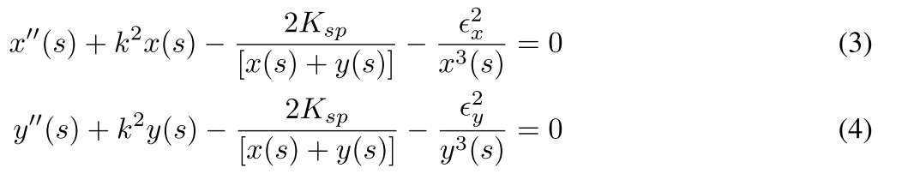
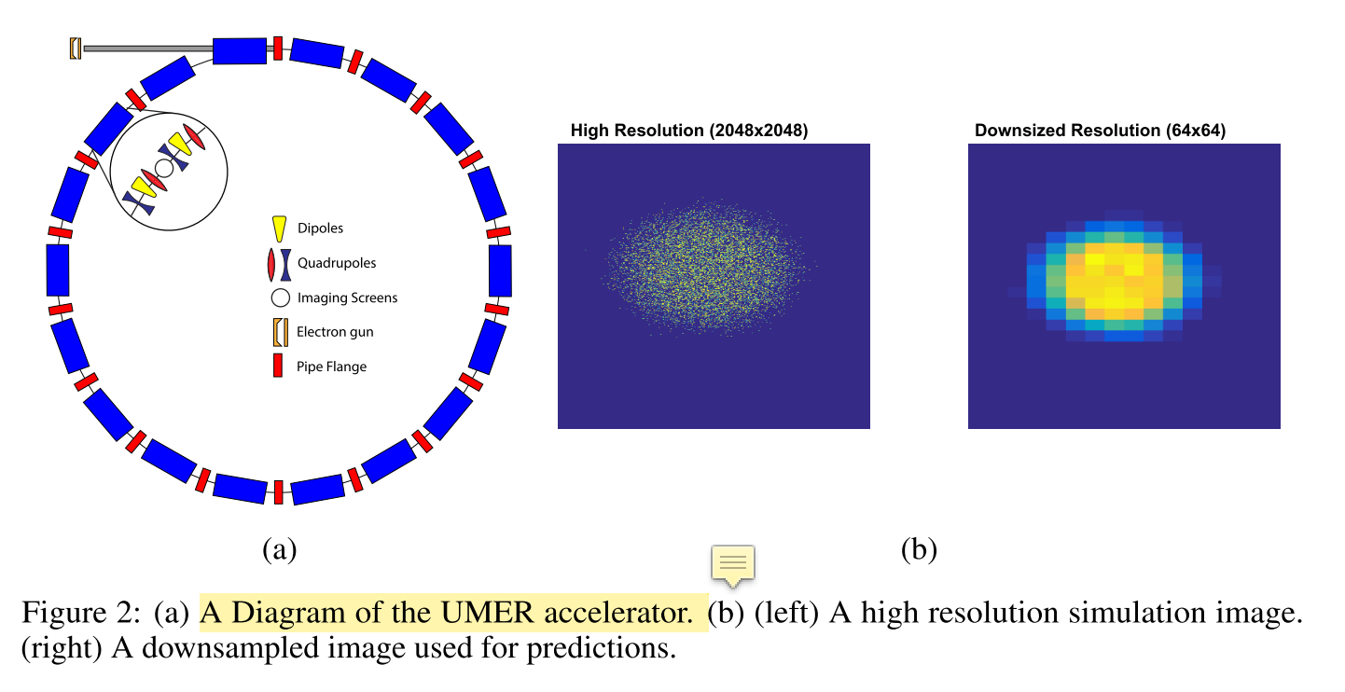
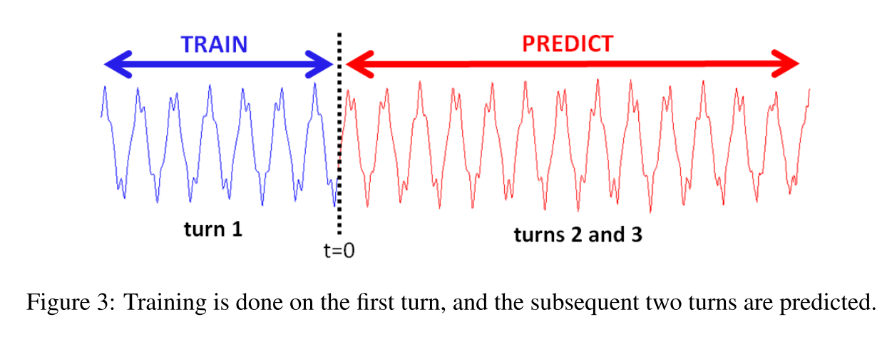

Chose to look at moment equations from Heidi’s paper
Looking at Heidi’s “$μ_{1}$” for x and y.

Slide 3
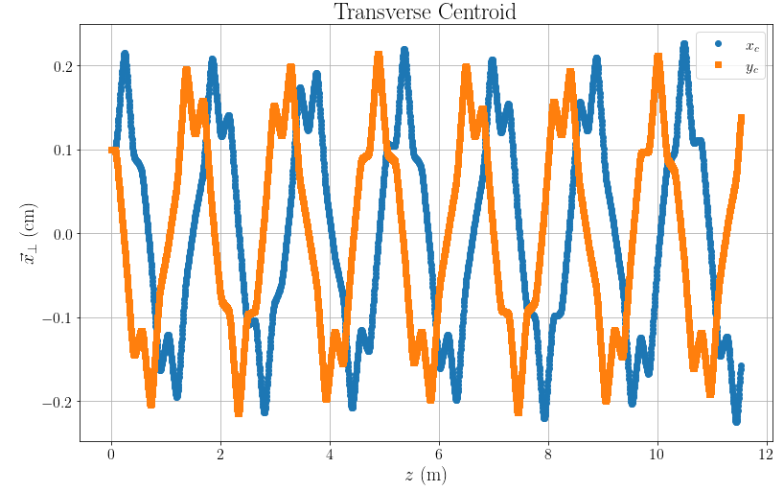
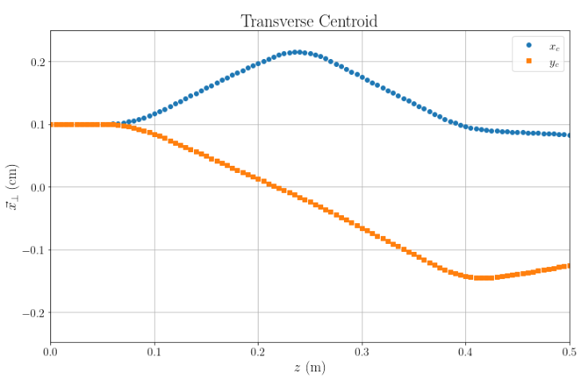
Data Reproduced
Making plots of data
One turn of UMER.

Slide 4
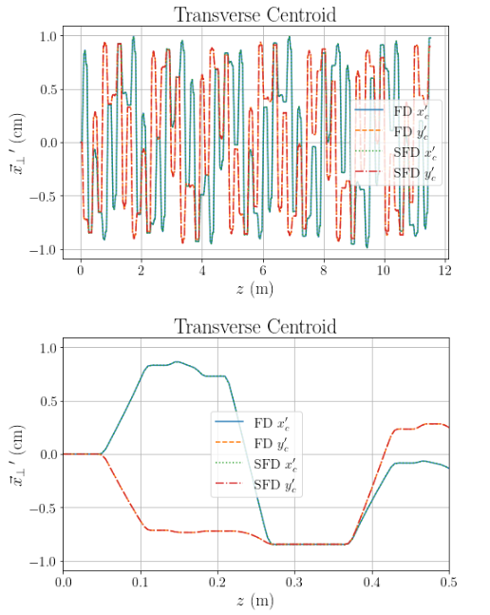
Playing around with differentiation
Differentiation of raw data doesn’t lead to good looking results in either python or Mathematica. Could do it by hand, but will just use algorithms to do it.

Slide 5
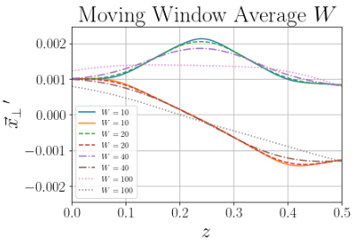
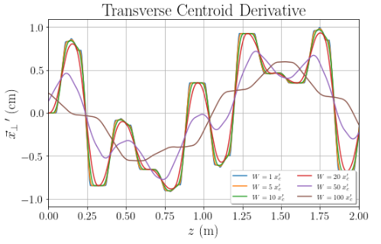
Moving window average (Boxcar Averaging)
Do variable boxcar average to get smoother derivative data to fit and try to get things done.
Smoother results for the x’ values

Slide 6

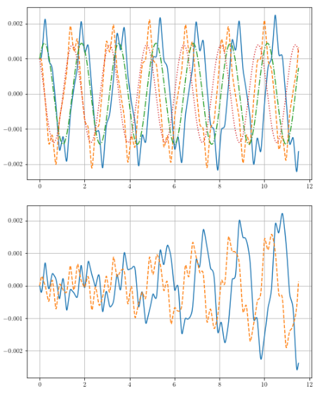
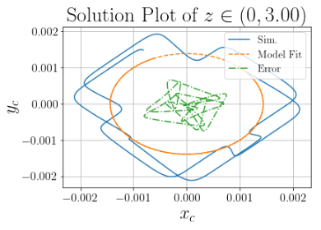
Result of Polynomial Library Fit
Linear fit more or less from sinusoidal behavior

Slide 7
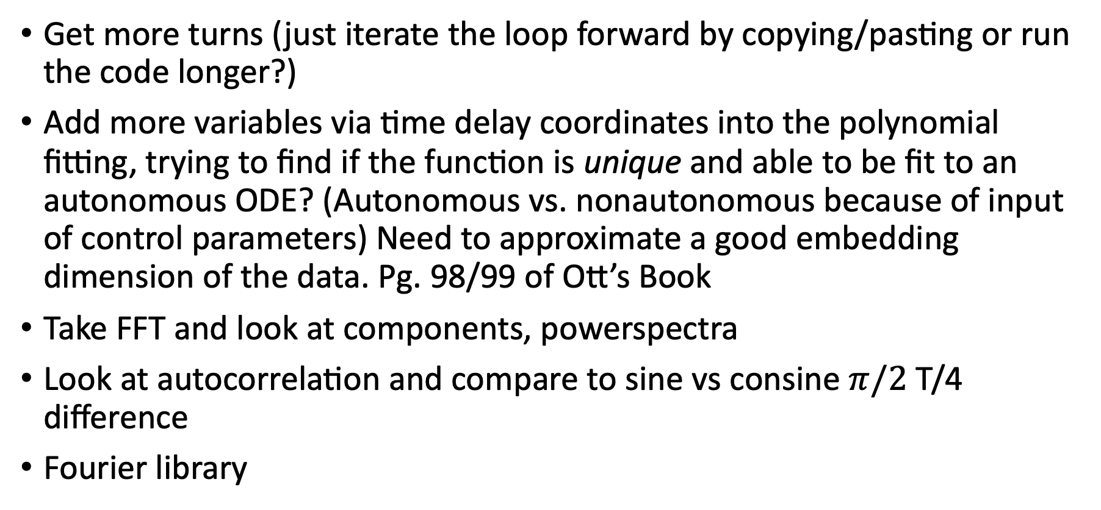
TODO
Get more turns (just iterate the loop forward by copying/pasting or run the code longer?)
Add more variables via time delay coordinates into the polynomial fitting, trying to find if the function is unique and able to be fit to an autonomous ODE? (Autonomous vs. nonautonomous because of input of control parameters) Need to approximate a good embedding dimension of the data. Pg. 98/99 of Ott’s Book
Take FFT and look at components, powerspectra
Look at autocorrelation and compare to sine vs consine $π/2$ T/4 difference
Fourier library

Slide 8
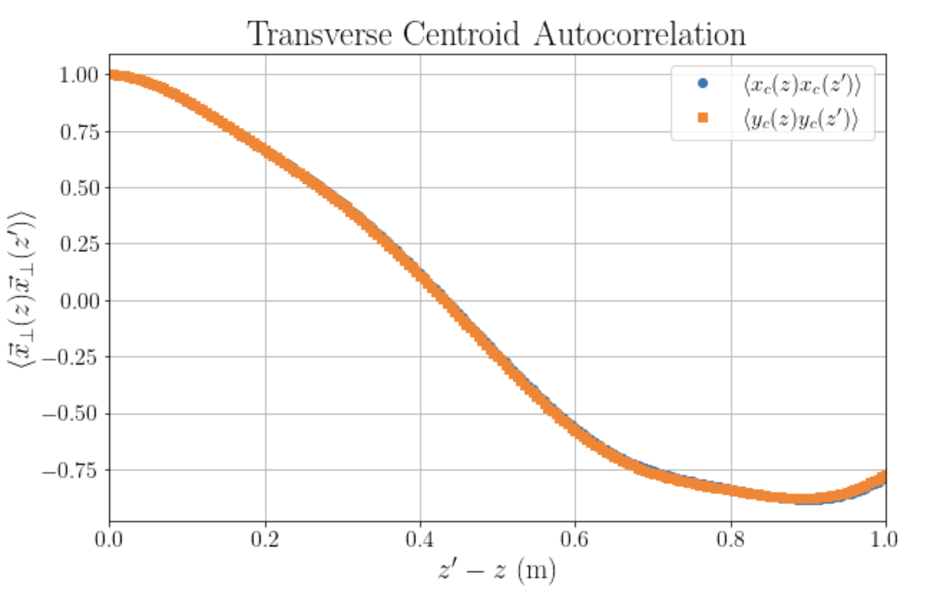
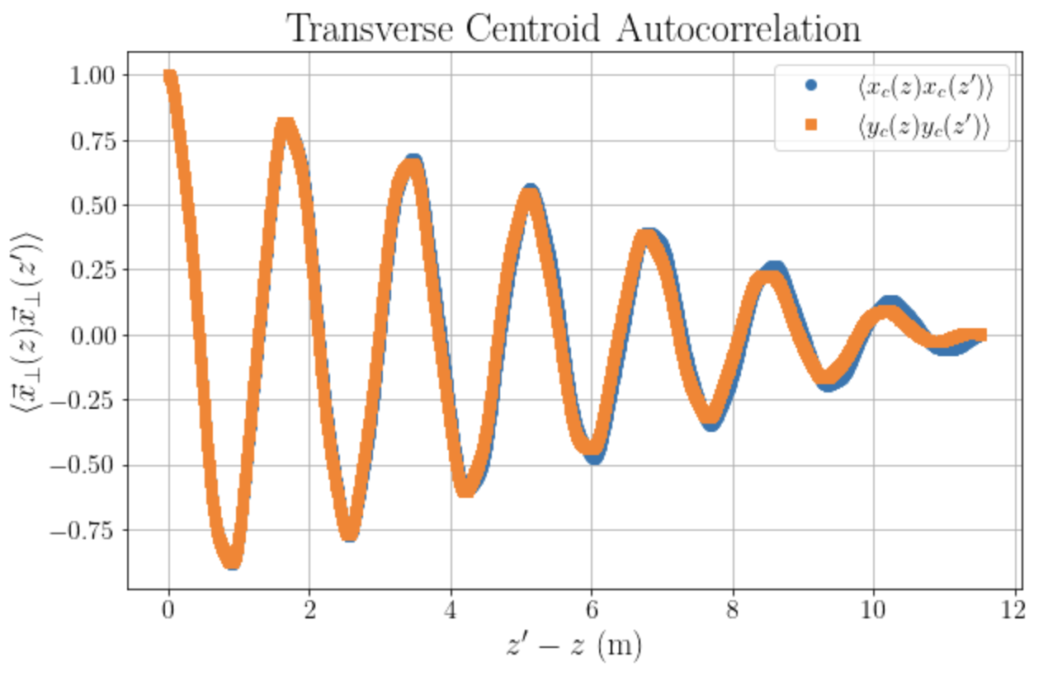

Embedding dimension
From Ott’s book we know that $d_{E}$ = embedding dimension needs to be $2 d_{KY}+1$ where $d_{KY}$ is the Kaplan-Yorke dimension
Coordinates can be added in order to make sure the trajectory is the delay coordinate phase space is unique, and does not intersect with itself.

Slide 9
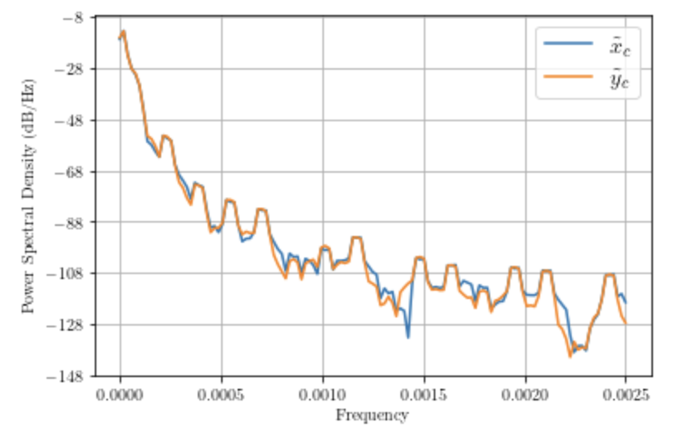
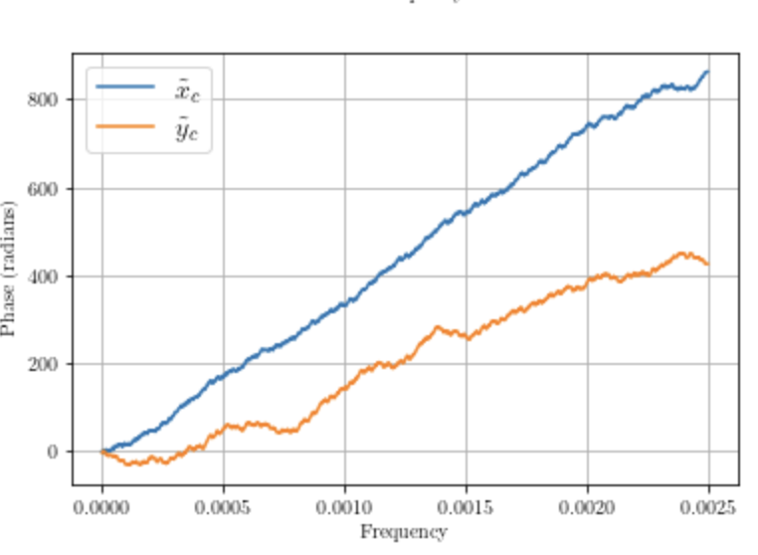
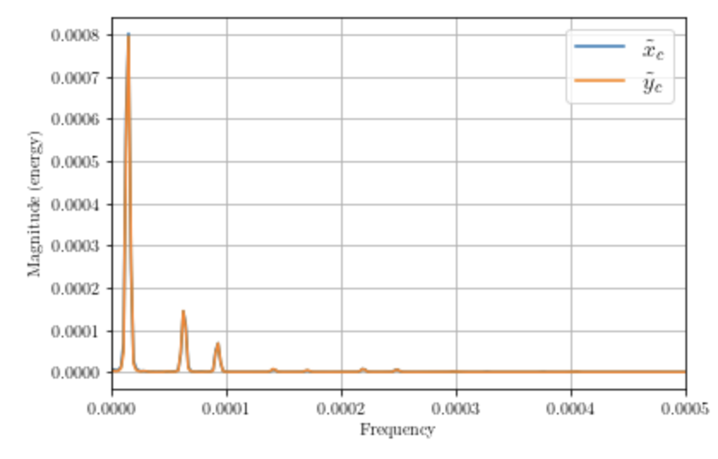
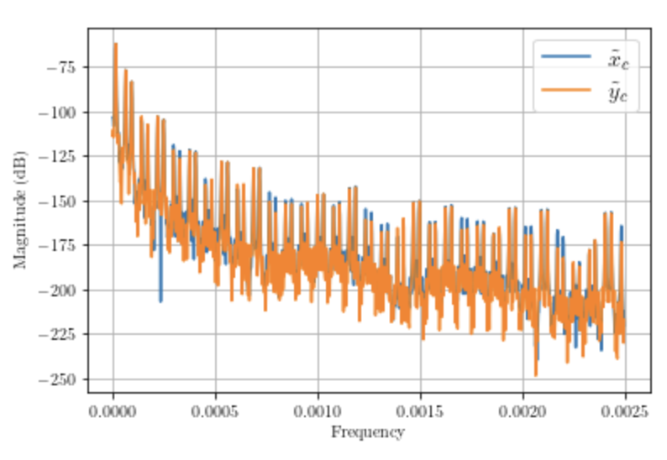

Frequency Analysis
Took Fourier transform and used python build in scripts to get psd, fourier transform etc.
The tilde $φ→ \tilde{φ}$ represents the fourier transform to the wavenumber space.
Note the frequency components
Fourier library analysis yields still similar behavior to the linear analysis.
What functions could be used to compute the data?
2D fourier analysis to find x,y spectra instead of just x(z) and y(z)?

